Slide 1
The Angels’ Big Entrance

Slide 2
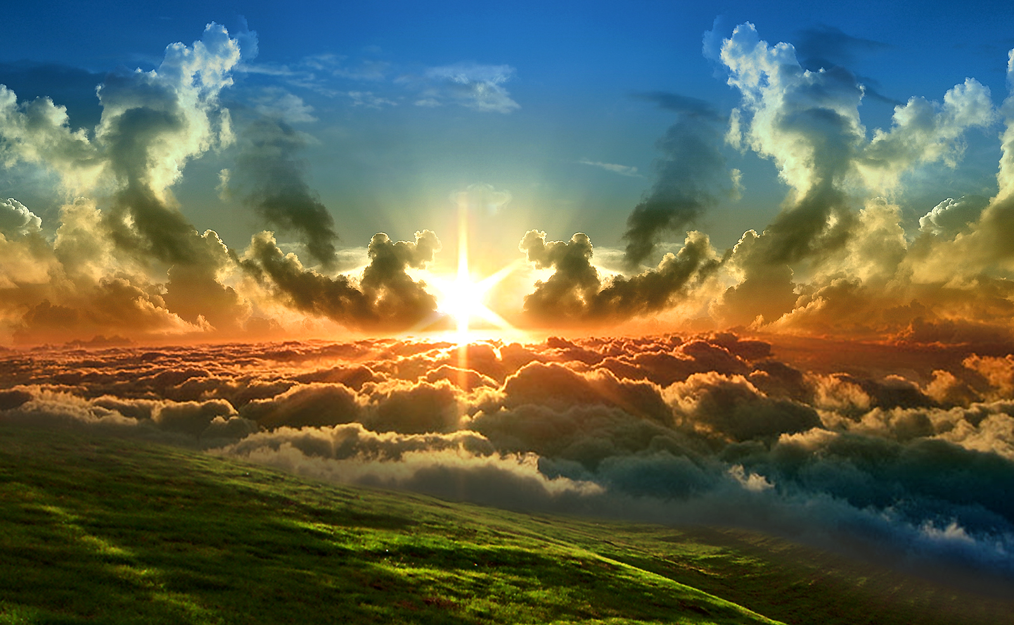

Slide 3
You have GOD -

Slide 4
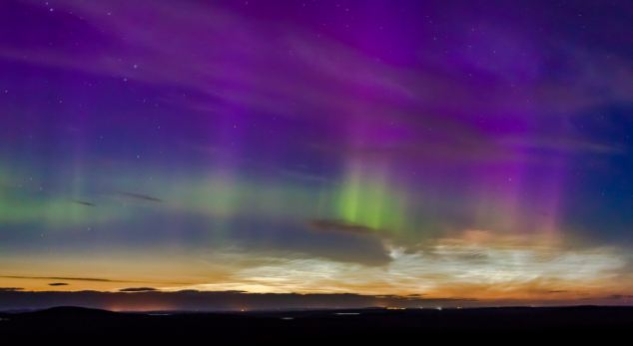
Angels from the realms of glory, Wing your flight o’er all the earth. Ye who sang creation’s story Now proclaim Messiah’s birth!

Slide 5
Come and worship, come and worship! Worship Christ, the newborn King.

Slide 7
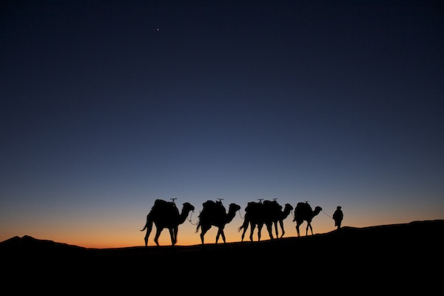

Slide 8
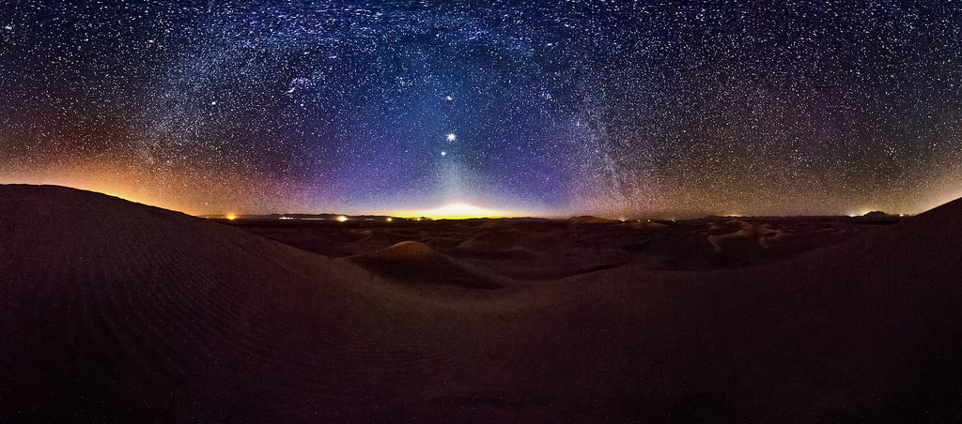
We three kings of Orient are; bearing gifts we traverse afar, field and fountain, moor and mountain, following yonder star.

Slide 9
O … star of wonder, star of night, star with royal beauty bright, westward leading, still proceeding, guide us to thy perfect light

Slide 10
Glorious now, behold Him arise, King, and God, and sacrifice! Heaven sings ‘Alleluia’, ‘Alleluia’ the earth replies

Slide 11
O … star of wonder, star of night, star with royal beauty bright, westward leading, still proceeding, guide us to thy perfect light

Slide 13
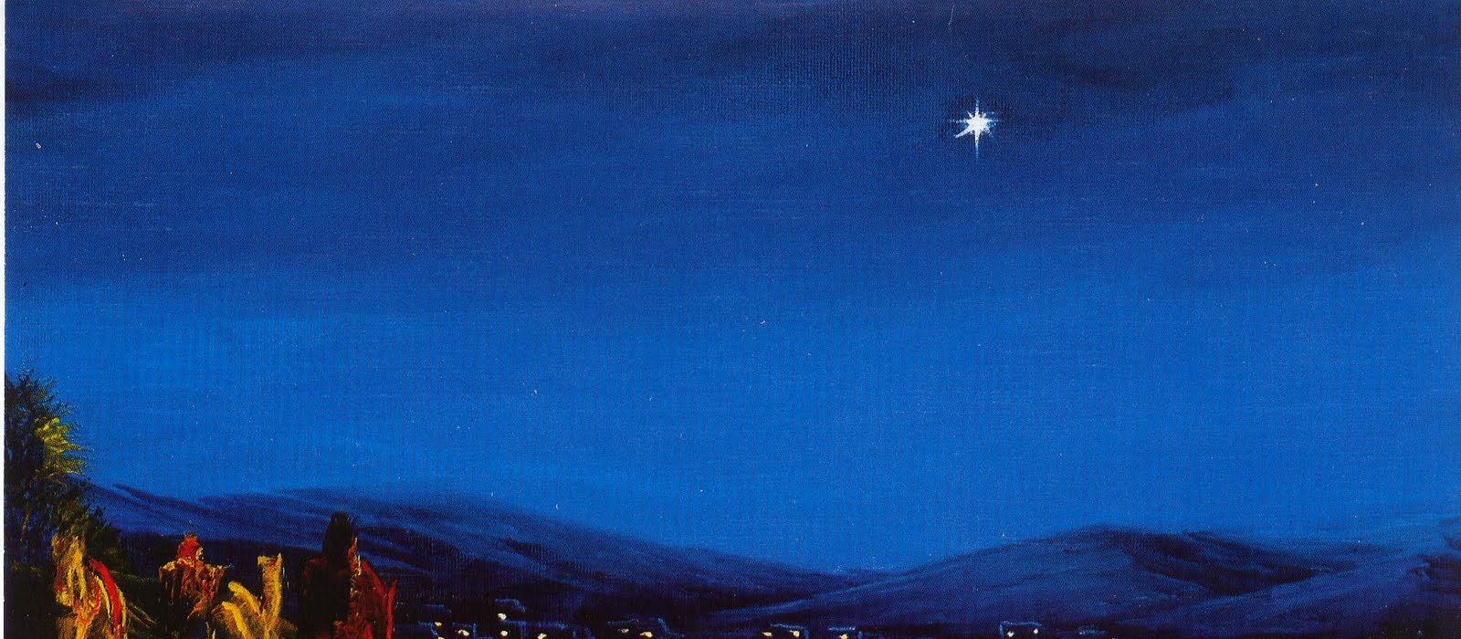

Slide 14
And did you see Him little star, long, long ago? and was it you, I wonder, shone on manger low? And did you see the shepherd men, when angels sang? ‘Peace on the earth, goodwill to all,’ the message rang.

Slide 15
And did you guide the three wise kings with shining light? and bring them to the holy Child on that great night? And will you still shine down on earth, though from afar, and lead us back to Bethlehem, O little star?

Slide 18
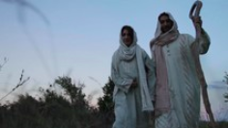

Slide 19
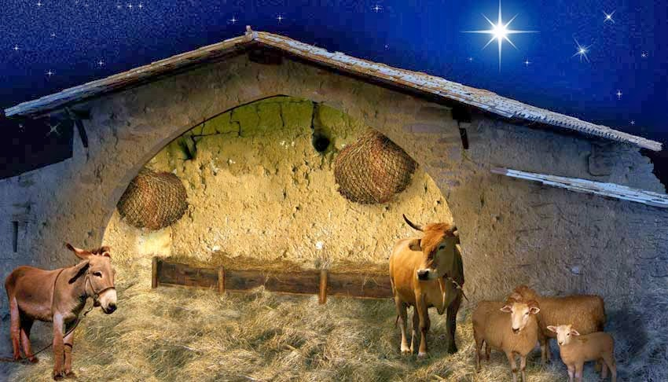

Slide 20
Away in a manger, no crib for a bed, The little Lord Jesus laid down his sweet head. The stars in the bright sky looked down where he lay, The little Lord Jesus asleep on the hay.

Slide 21
The cattle are lowing, the baby awakes, But little Lord Jesus no crying he makes. I love thee, Lord Jesus! Look down from the sky, And stay by my side until morning is nigh.

Slide 22
Be near me, Lord Jesus; I ask thee to stay Close by me forever, and love me, I pray. Bless all the dear children in thy tender care, And fit us for heaven to live with thee there.

Slide 23
You have GOD -

Slide 24
The first Noel the angel did say Was to certain poor shepherds in fields where they lay: In fields where they lay a keeping their sheep on a cold winter's night that was so deep.

Slide 25
Noel Noel Noel Noel Born is the King of Israel!

Slide 26
You have GOD -

Slide 27
The first Noel the angel did say Was to certain poor shepherds in fields where they lay: In fields where they lay a keeping their sheep on a cold winter's night that was so deep.

Slide 28
Noel Noel Noel Noel Born is the King of Israel!

Slide 30
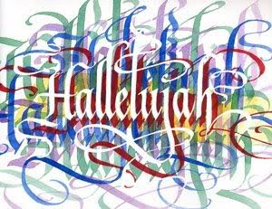

Slide 31
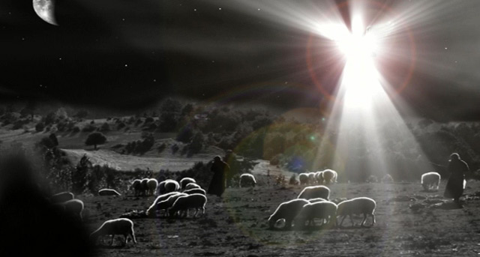

Slide 32
While shepherds watched their flocks by night, all seated on the ground; the angel of the Lord came down, and glory shone around.

Slide 33
"Fear not!" said he, for mighty dread had seized their troubled mind. "Glad tidings of great joy I bring to all of humankind

Slide 34
"To you, in David's town, this day is born of David's line a Savior, who is Christ the Lord, and this shall be the sign

Slide 35
"The heavenly babe you there shall find to human view displayed, all meanly wrapped in swathing bands, and in a manger laid.”

Slide 36
Thus spake the seraph and forthwith appeared a shining throng of angels praising God, who thus addressed their joyful song:

Slide 37
"All glory be to God on high, and to the earth be peace; good will henceforth from heaven to men begin and never cease.”

Slide 39
The stars danced, the angels sang the night God came to earth. The whole vault of heaven rang to celebrate his birth.

Slide 40
We will dance, we will sing, we will praise our heavenly King at his birth!

Slide 41
Mary, his mother smiled to see her babe new born. Shepherds came hurrying, left their flocks forlorn.

Slide 42
We will dance, we will sing, we will praise our heavenly King at his birth!

Slide 43
Wise men who saw his star, knew their Lord was here, came with their offerings, incense, gold and myrrh.

Slide 44
We will dance, we will sing, we will praise our heavenly King at his birth!

Slide 45
We too will give to him gifts of love and praise. Dance for him, sing for him, rejoice in him always.

Slide 46
We will dance, we will sing, we will praise our heavenly King at his birth!

Slide 48
